Slide 1
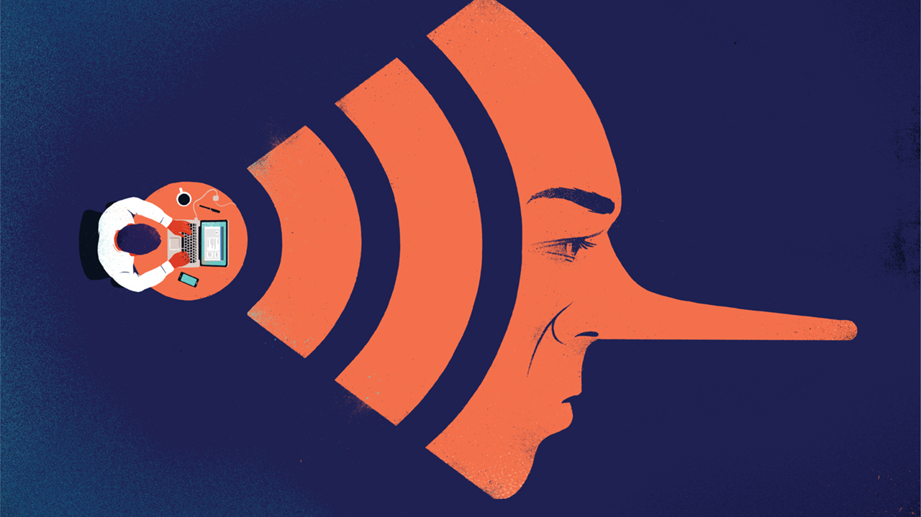
Think Like a Scientist
(Even If You’re Not One)
Making Sense of Messy Problems in a Complicated World

Slide 2
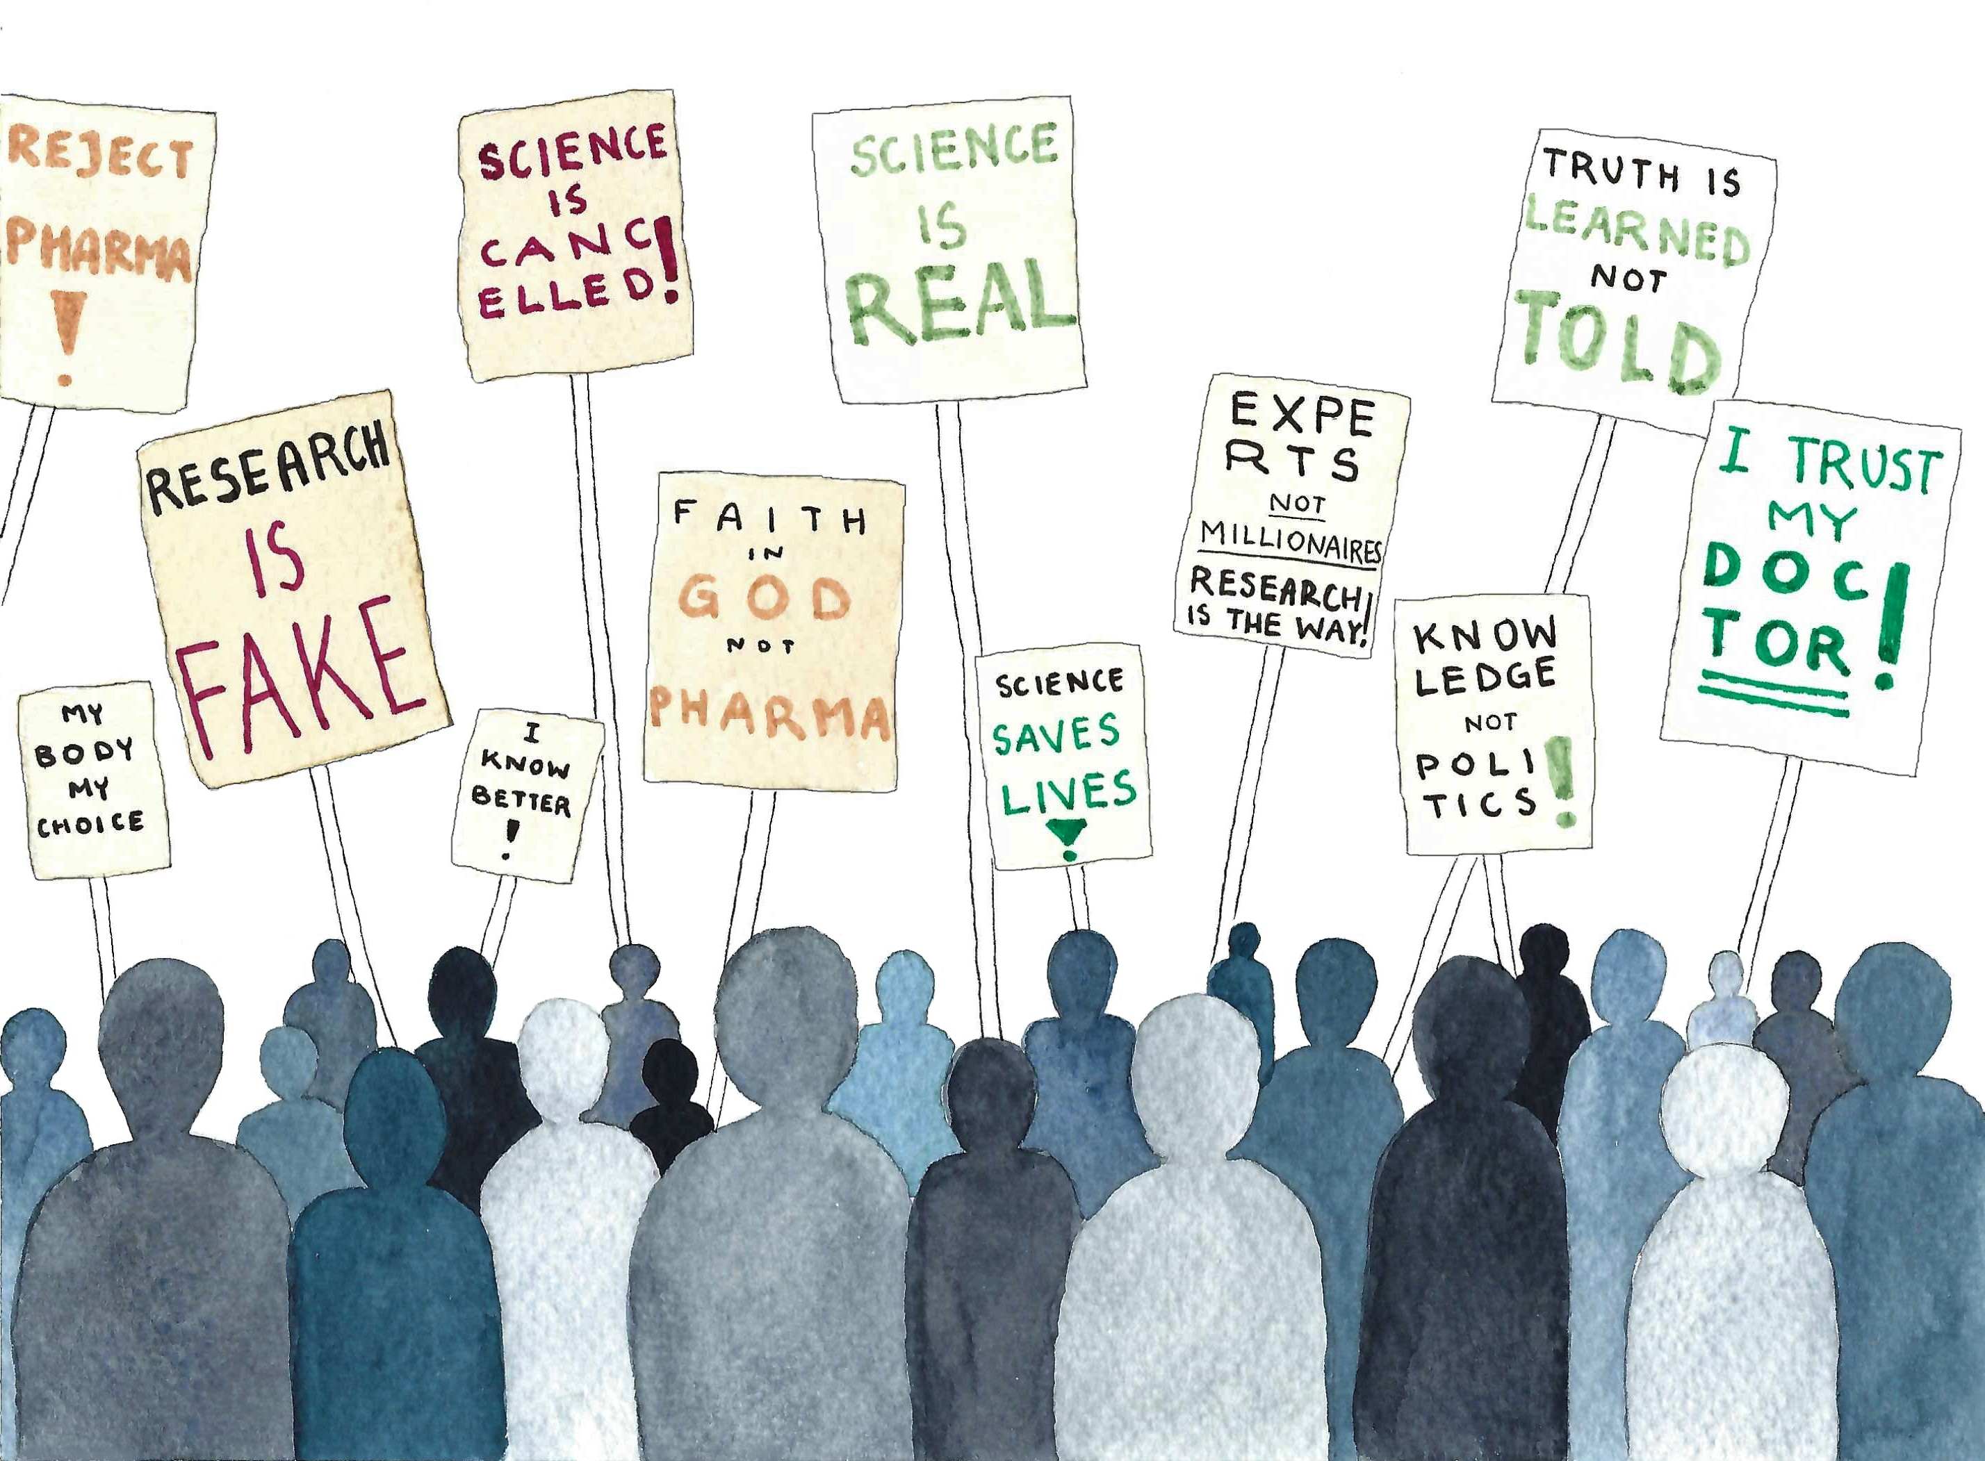
Two Challenges for Science Today
Eroded Trust: Many people no longer trust science or scientists
Mis/dis-information: False claims spread faster than ever

Slide 3
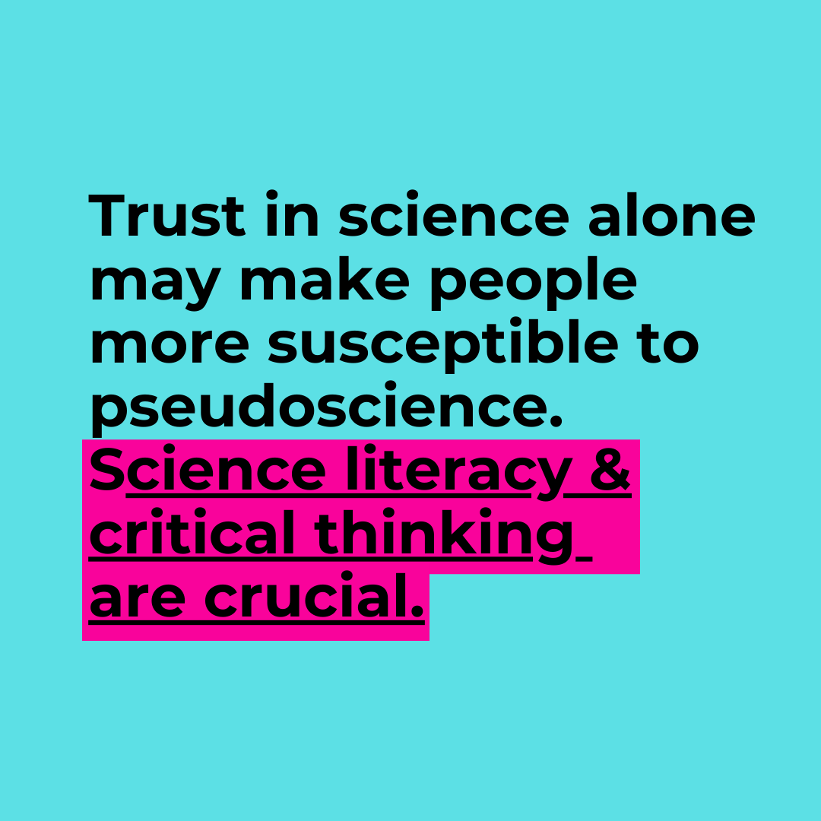
What can you do?
You don’t need to be a scientist to be scientifically literate
But you do need to know how to ask the right questions

Slide 4
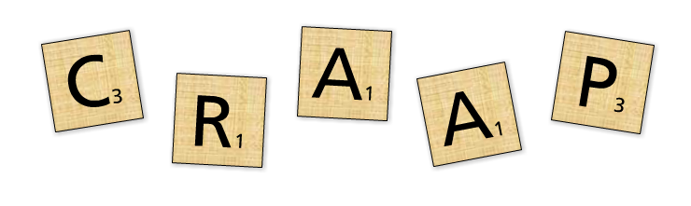
STOP CRAAP
STOP = Stop, Think, Observe, Proceed
Use lateral reading
Acknowledge your own biases
Currency
Relevance
Authority
Accuracy
Purpose

Slide 5
Nature of Science
Theories = highest level of certainty
01
Peer review is how scientists check each other
02
Science doesn’t deal in absolute truth — it’s always refining
03

Slide 6
What Science Is
A method for understanding the natural world
01
Evidence-based, testable, repeatable
02
Not driven by belief, feeling, or popularity
03

Slide 7
“Science is not a democracy — it’s a meritocracy of ideas”
Scientific claims are evaluated based on the quality of evidence, soundness of logic, and reproducibility of results, not on who proposed them or how popular they are. The best-supported ideas rise to the top — not because people voted for them, but because they withstood scrutiny and testing.

Slide 8
Science and Society
Science helps us understand and solve real-world problems
But science isn’t the only thing to consider

Slide 9
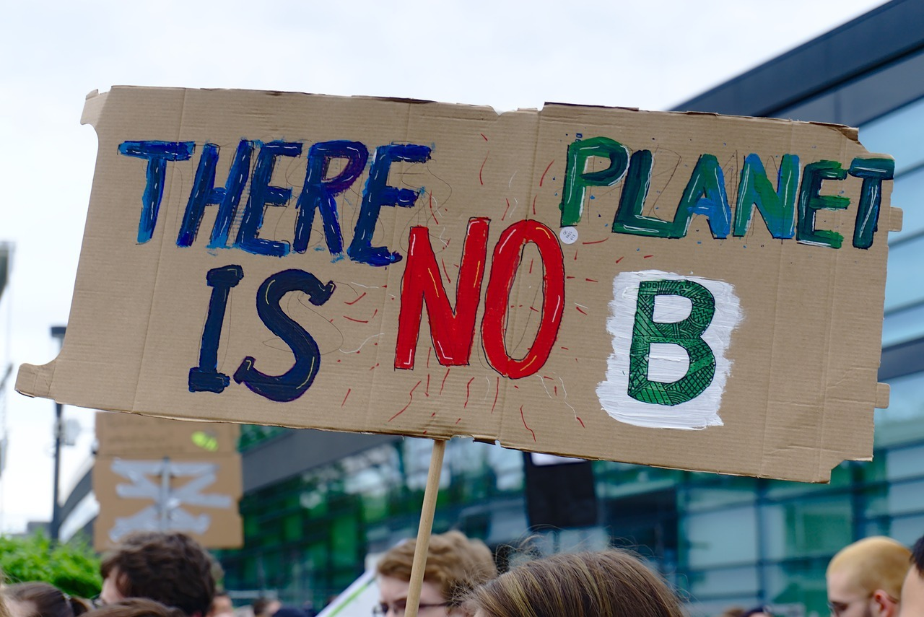
Socioscientific Issues Are Messy
There are no silver bullets
Science helps identify the problem and possible solutions
Public trust and cooperation are essential

Slide 10

We can’t solve these problems if we’re not starting from the same facts
Use your scientific literacy to:
Think critically
Engage constructively
Make informed decisions

Slide 11
Reflection
“What’s one thing you’ll do differently after this course?”

